Slide 1
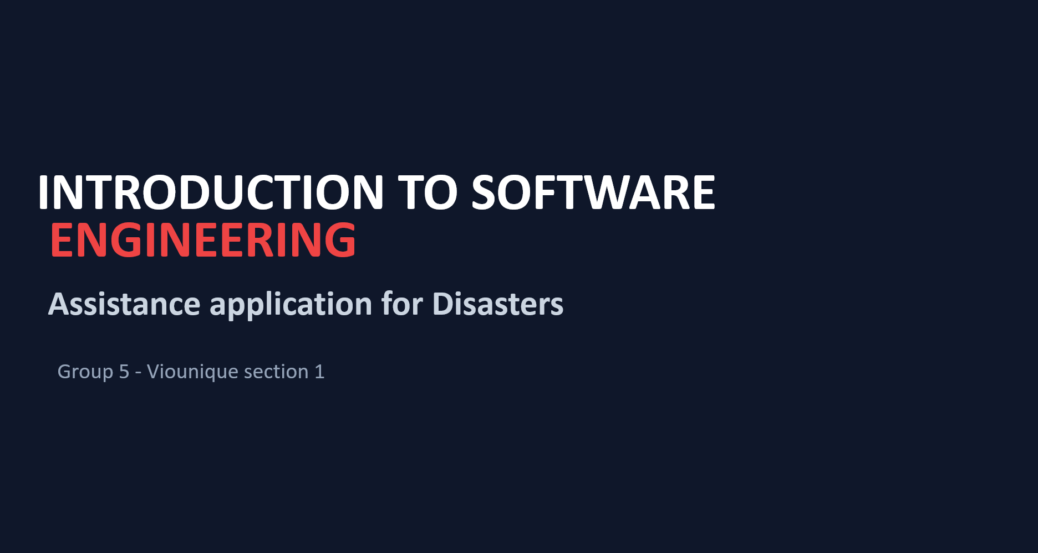

Slide 2
EXECUTIVE SUMMARY
Project Overview
Project
Team
Assistance Application for Disasters
Viounique
SDLC
Goal
Agile
Build an emergency assistance system that helps victims report their situation and helps rescue teams coordinate responses.

Slide 3
PROBLEM STATEMENT
Problem
Floods in Myanmar and Thailand isolate victims due to damaged infrastructure and poor communication. Rescue teams receive incomplete or delayed location reports, making it difficult to identify and prioritize urgent cases, especially vulnerable people such as the elderly, infants, and bedridden patients. Meanwhile, disconnected emergency systems cause inconsistent, duplicated, and unreliable data, delaying rescue coordination and mission dispatches.

Slide 4
TARGET STAKEHOLDERS
Who is Affected
This issue impacts stakeholders across the entire response chain- from Incident Command Centers lacking operational visibility and Field Rescuers overburdened by fragmented workflows, to High-Risk Vulnerable Victims who rely on specialized medical equipment, such as bedridden patients requiring oxygen support or hemodialysis patients.

Slide 5
RISK & IMPACT
Impact & Urgency
Delays caused by manual coordination result in the loss of the critical "Golden Hour" needed to save lives. Furthermore, it causes severe misallocation of rescue capacity by deploying specialized assets-such as flat-bottom boats or portable power stations-to the wrong locations or to cases that do not match the actual urgency level.

Slide 6
MVP SCOPE
Main Features
The MVP includes:
•
Victim Request Logging - victims submit GPS location and assistance type.
•
Offline/Online Synchronization - requests are saved offline and automatically uploaded when the connection returns.
•
Live Rescue Map - coordinators see emergency requests on a real-time map.
•
Priority Scoring - urgent and vulnerable cases receive higher priority.
•
Communication & Contact - coordinators can contact victims by phone.

Slide 7
USER ROLES
Main Users
There are two main stakeholder groups:
•
Flood victims - submit their location and assistance needs.
•
Emergency coordinators - monitor cases using a live map and allocate resources.

Slide 8
REQUIREMENTS DETAILS
FR-1 - Victim Request Logging
Must MVP
Goal: Enable flood victims to quickly send distress requests with precise GPS & flags
Data Captured
System Logic & Validation
•
Contact & Basic Info: Phone, Name, Number of People
Happy Path
•
Complete info + GPS granted -> Save request (Status: "Submitted")
•
Precise Location: GPS Lat / Long (+ Accuracy meter)
•
Request Category: Medical / Evacuation / Food & Water
Edge Cases
•
Special-Care Flags: Bedridden, Infant, Elderly, None
•
GPS denied / unavailable -> Prompt map pin or text landmark, Accept & tag "Location Unverified"
•
Missing required fields -> Block submission + Highlight field

Slide 9
REQUIREMENTS DETAILS
FR-2 - Offline Capture & Automatic Sync
Must MVP
Goal: Ensure requests are saved locally without signal & synced when online
Key Mechanics
System Logic & Validation
•
Local Persistence: Saves request directly to device when offline
Happy Path
•
No Internet Connection: Save to device ("Offline pending") and display banner "Not sent yet - will send automatically"
•
Automatic Synchronization: Background sync within 60 seconds once connected; status updates to "Submitted"
•
Network Connection Restored: Auto-upload within 60 seconds and change status to "Submitted"
•
Duplicate Prevention: Reuses client-generated Request ID across all retry attempts
Edge Cases
•
App Force-closed or Device Restarted: Request stays pending and syncs on boot
•
Upload Failure (Timeout / Server Error): Retry every 30 seconds using the same ID to guarantee exactly one server copy

Slide 10
REQUIREMENTS DETAILS
FR-3 - Coordinator Live Map with Filters
Must MVP
Goal: Provide rescue coordinators a real-time spatial map to allocate resources efficiently
Map Features
System Logic & Validation
•
Priority Visuals: Pin colors (Red / Yellow / Green) based on calculated priority
Happy Path
•
Open Map View: Plot all active requests as pins at recorded coordinates
•
Dynamic Filtering: Filter by emergency type, priority level, status, and vulnerability flags
•
Apply Multi-Filter: Filter by type, priority, or status, and instantly update pin display and match count
•
Visual Indicators: Unverified locations get dashed outlines and warning tooltips
•
Real-Time Data Stream: New requests appear within 10 seconds without manual refresh
Edge Cases
•
No Matching Requests / Empty State: Display "No matching requests" message and show a "Clear-filter" button
•
Location Unverified Flag: Render pin with a dashed outline and show tooltip "Location not confirmed"

Slide 11
REQUIREMENTS DETAILS
FR-4 - Rule-based Priority Scoring
Must MVP
Goal: Automatically assign Red / Yellow / Green priority to every request using fixed safety rules so life-threatening cases sit at the top of the queue
Scoring Rules (Highest severity wins)
System Logic & Validation
•
Red: Any care flag is set (bedridden, infant, elderly) OR emergency type = Medical
Happy Path
•
Request submitted with care flag: Assigned Red priority within 2 seconds
•
Yellow: Emergency type = Evacuation or Other with no care flag; OR data incomplete/contradictory (tagged "needs review")
•
Request submitted as Food & Water (no flags): Assigned Green priority
•
Green: Emergency type = Food & Water only, with no care flag and complete data
•
Queue Display: Automatically sorted Red → Yellow → Green (oldest first)
Edge Cases
•
Multiple matching rules (e.g., Food & Water + infant): Applies highest severity (Red)
•
Incomplete or contradictory data: Assigned Yellow priority with "needs review" tag

Slide 12
REQUIREMENTS DETAILS
FR-5 - Contact Victim & Case Status
Must MVP
Goal: Allow coordinators to call victims directly from the dashboard and update case status before dispatching teams
Case Status Flow
System Logic & Validation
•
Primary Flow: Submitted → Verified → Dispatched → Rescued
Happy Path
•
Click Call button: Opens device dialer with victim's phone number
•
Side Exits: Unreachable, Canceled
•
Update Status: Saves status, timestamp, coordinator name; updates dashboard in 10s
Edge Cases
•
Missing/Invalid phone number: Disables Call button + tooltip "No valid number"
•
False/Unconfirmable request: Status set to "Unreachable" / "Canceled"; preserved in case log

Slide 13
SYSTEM CONSTRAINTS
Non-Functional Requirements
•
Map should load within 5 seconds on standard 4G.
•
Status notifications should arrive within 30 seconds.
•
A first-time victim should be able to submit a request within 45 seconds.
•
Offline data must not be lost if the app crashes or the phone restarts.
•
Coordinators can only access requests from their authorized sector.

Slide 14
PROJECT BOUNDARY
System Scope Control & MVP Boundaries
IN SCOPE (MVP Delivered)
OUT OF SCOPE (Explicit Boundary)
•
Victim Distress Logging: Log requests with precise GPS coordinates.
•
Internal chat between users
•
AI medical diagnosis or clinical advice
•
Offline Data Sync: Store locally & auto-sync upon connection.
•
Reading or summarizing external LINE/Messenger/social-media groups.
•
Live Map Dashboard: Real-time incident plotting with filter controls.
•
Rule-based Triage: Flag bedridden patients & infants as Red Code.
•
Direct Call Trigger: One-click victim verification for coordinators.

Slide 15
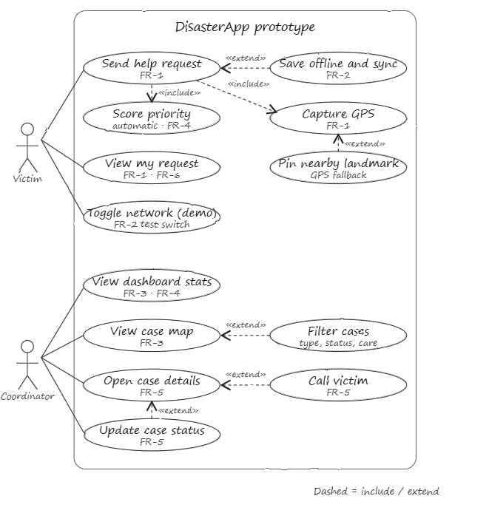
Use-Case Diagram
SYSTEM MODELING
Important use cases include:
Log distress request
Report accident
Sync offline data
Receive notifications
View and filter the live map
Calculate priority
Classify emergency types
Contact victims
Allocate rescue resources
Generate reports
Respond to emergencies

Slide 16
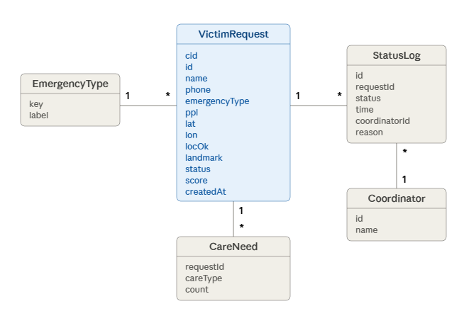
Class Diagram
DATA ARCHITECTURE

Slide 17
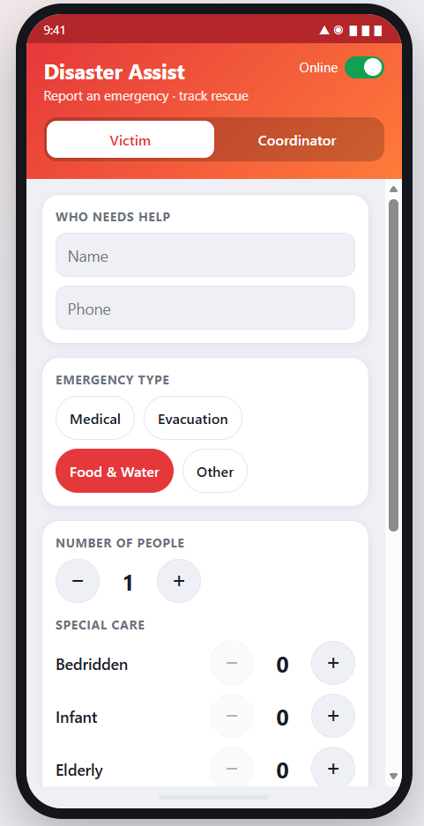
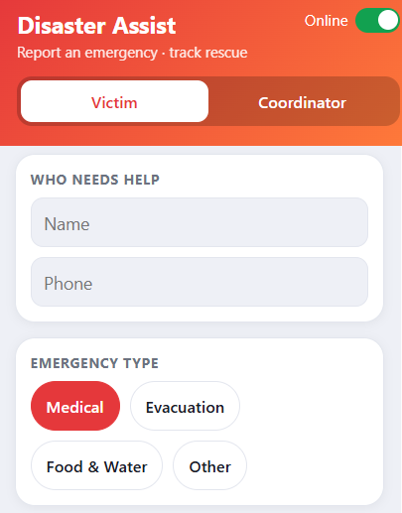
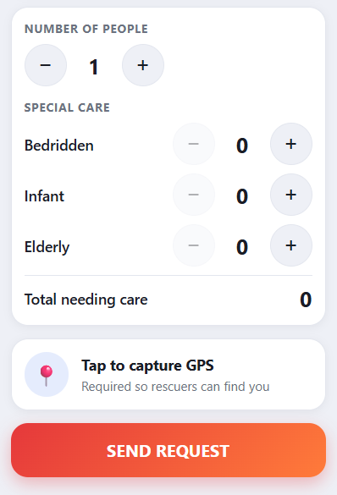
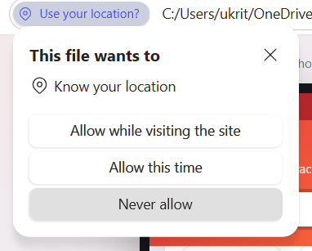
Victim Distress Logging UI

Slide 18
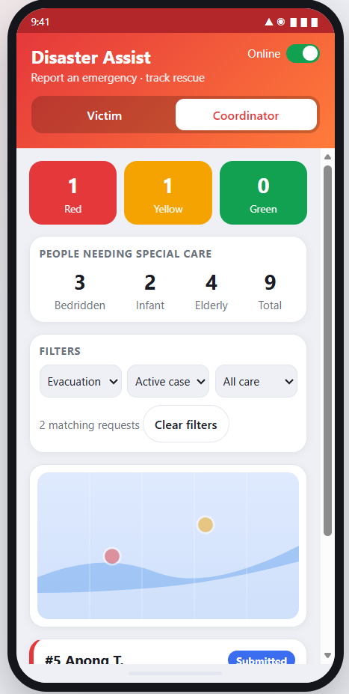
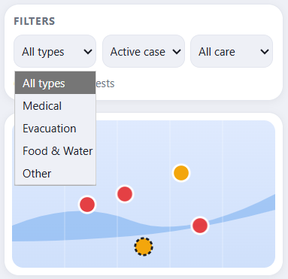
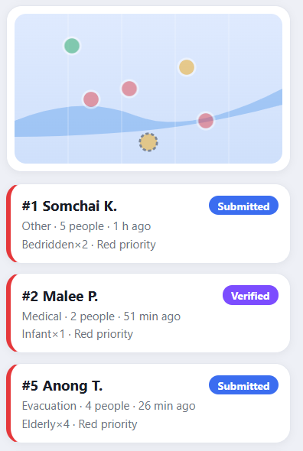
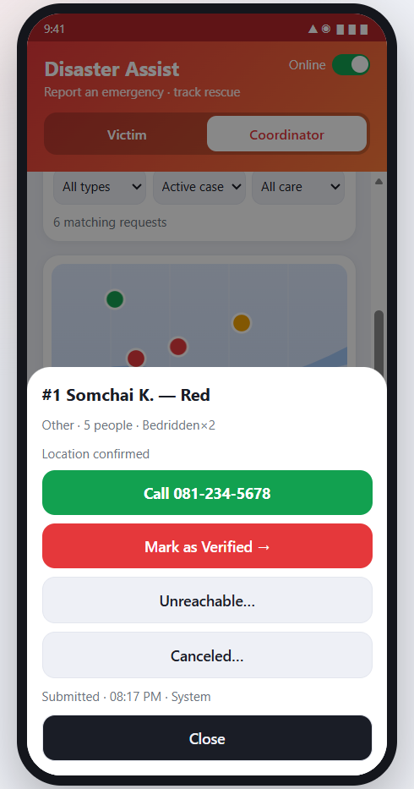

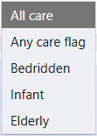
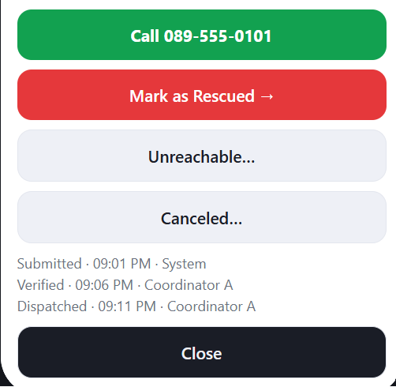
Coordinator Distress Logging UI

Slide 19
SYSTEM VALIDATION
Traceability
The SRS connects each problem to a requirement, design, feature, and test. FR-3 (Live Rescue Map) is the main complete "Golden Thread" being followed through the course milestones.

Slide 20
DOCUMENTATION
AI Usage Log
The team used Gemini to research flooding problems in Southeast Asia. The AI output was then edited and converted into specific software problems and requirements rather than being used directly.
•
•
The team use Chat GPT to summarize the information and review our project.
•
The team use Claude to review our code and prototype and receive suggestion .

Slide 21
CONCLUSION
One-Sentence Presentation Summary
"Our project is an emergency assistance system that collects victims' GPS-based distress requests, stores them locally when the internet is unstable, and automatically transmits them once connectivity is restored, giving rescue coordinators a live map and priority information so they can respond to the most urgent cases efficiently."

